Slide 1
KpK Culture
Presented by
Muhammad Sualeh Hannan 4178-FBAS/BSCS4/F19
Shehbaz khan 4161-FBAS/BSCS4/F19
Ashir Naeem Abbasi 4175-FBAS/BSCS4/F19
Muhammad Hasnain 4171-FBAS/BSCS4/F19

Slide 2
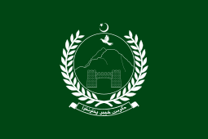
Flag of Kpk

Slide 3
Introduction
Formally Known as the North-West Frontier province (NWFP).
Located in the north-west of the country.
Khyber Pass link the Province to Afghanistan.
The Kohala Bridge in Balakot Abbottabad is a major crossing point over the Jhelum River in the east.
Established: July 1,1970.
Capital Peshawar.
Area: 101,741 km²
Districts: 38
Population: 35,520,000 Estimated. (2017)
Density: 300sq.km
Divisions: 7 (Bannu Division, Dera-Ismail Khan Division, Hazara Division, Kohat Division, Malakand Division, Mardan Division, Peshawar Division.

Slide 4
Continued
The main ethic group in the province is Pashtun; other smaller ethnic groups include most notably the Hazarewals and Chitralis Language.
From the majestic peaks of the Hindu Kush to the bustling streets of Peshawar, KPK is home to a vibrant mosaic of ethnic groups (Pashtuns,Awan,Afridi,Khattak,Hindkowans,Swati tribe,Musakhel etc.), each contributing its unique hues to the cultural fabric.
We will navigate the threads that bind communities together, the expressions of art and literature that captivate hearts, the rhythms of music and dance that stir the soul, and the delectable flavors that tantalize the taste buds.

Slide 5
Geographical and Historical Context
KPK is situated in the northwestern part of Pakistan and shares borders with Afghanistan. It is known for its breathtaking mountain ranges, including the majestic Khyber Pass, Swat Valley, and the beautiful peaks of the Hindu Kush range.
Ancient History:
Alexander’s Rule, Mauryn’s Rule, Kushan Empire , Turks and hindus shah.
Medieval Period:
Ghaznavids and Delhi Sultanate
Early Modern History:
Mughal Empire , Durrani Empire , British Raj, Pakistan

Slide 6
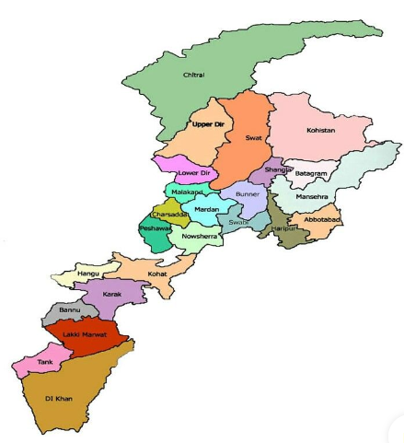
Map of kpk

Slide 7
Pashtun Culture & Heritage
Pathan is not merely a race but in fact a state of mind there is a pathan inside every mind.
The dominant ethnic group in KPK is the Pashtuns, who have a distinct culture deeply rooted in tradition and honor.
The Pashto language, known for its melodious and poetic nature, is widely spoken and forms an integral part of their identity. (Khushal Khan)
Pashtunwali, the Pashtun code of conduct, guides their social interactions and emphasizes hospitality, bravery, and loyalty.

Slide 8
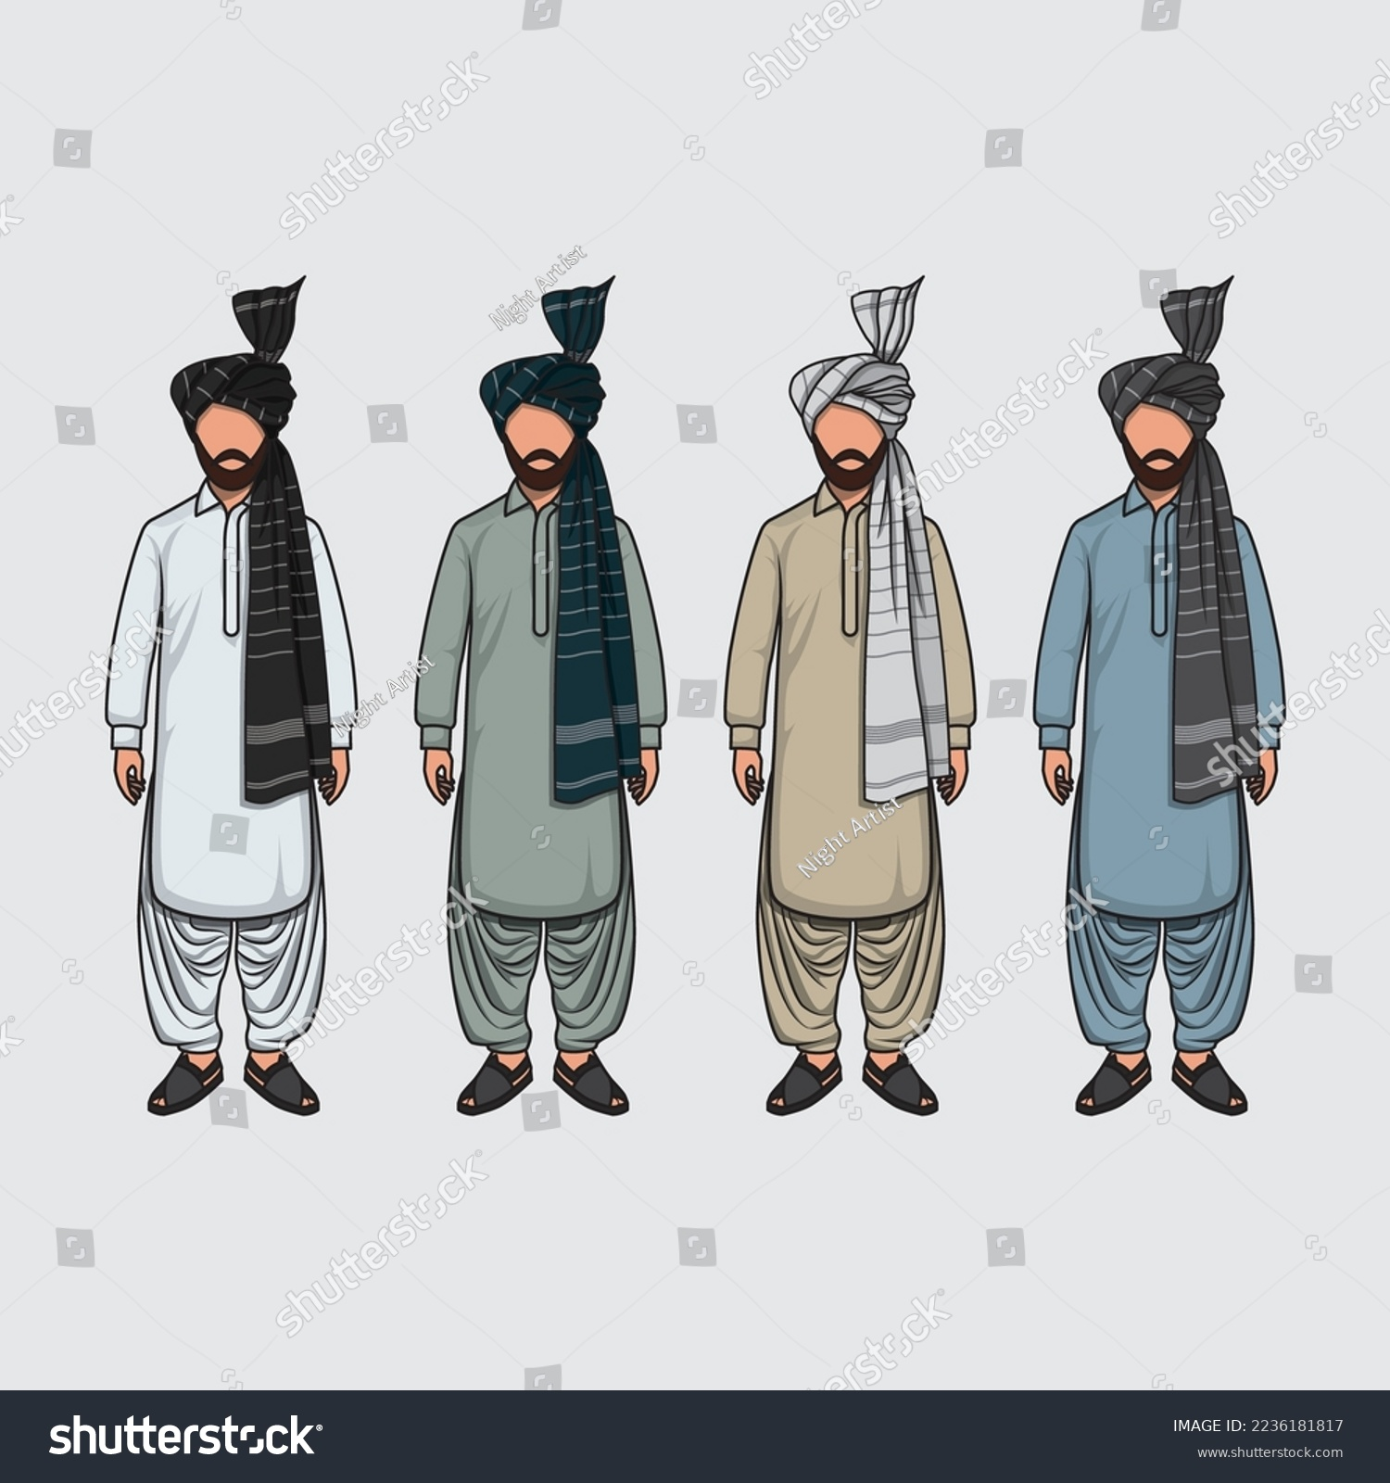
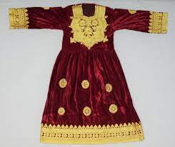
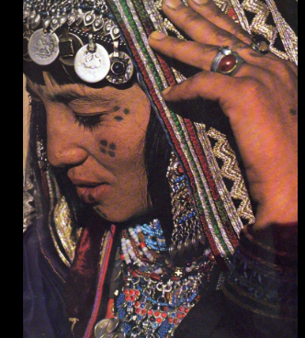
Traditional dress and clothing
Headwear and Turban’s , Women's Clothing and Tattoos(Ghilji tribe/Kochi people).

Slide 9
Pashtunwali
Code of Conduct
“Pashtun believes that their social code produces men, who are superior to those produce under the western model, and they have no desire to have a new social system imposed on them by outsiders”( Thomas H. Johnson and M. Chris Mason).
Main components of Pashtunwali
Melmastia (Hospitality)
Badal(to seek justice or take revenge against the wrongdoer)
Nanawatai (santuary) to seek refuge in the house of another, seeking asylum against his enemies

Slide 10
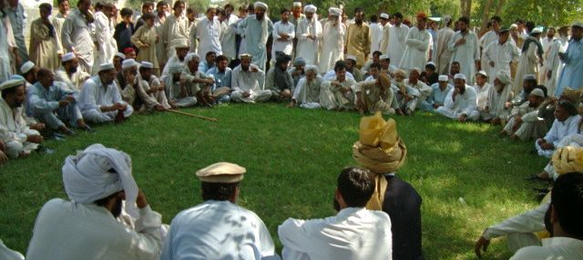
Jirga And Hujra System
Assembly of tribal elders.
Take decision on issues based on consensus.
Dispute between two or more people heard by this council of Elders.
In tribal regions, the jirga is still used as a court for criminal offence.

Slide 11
Pashto Poets
Some notable poets from the region of kpk include
Rahman Baba
Khushal khan Khattak
Ghani khan

Slide 12
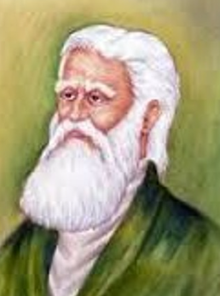
Pashto Poets
Rehman Baba :
Abdur Rahmān Momand or Rahmān Bābā, was a renowned Pashtun Sufi Dervish and poet from Momand Agency in Peshawar during the Mughal era. He, along with his contemporary Khushal Khan Khattak, is considered to be one of the most popular poets among the ethnic Pashtuns.
Born: 1632, Peshawar
Died: 1706, Peshawar

Slide 13
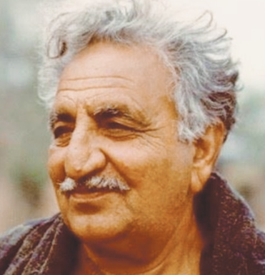
Pashto Poets
Ghani Khan :
Khan Abdul Ghani Khan SI was a Pashtun philosopher, poet, artist, writer and politician. He was a son of Abdul Ghaffar Khan, a prominent British Raj-era Indian independence activist. Throughout his life as a poet in both British India and Pakistan, Khan was known by the titles Lewanay Pālsapay and Da īlam Samander
Born: 1914, Hashtnagar
Died: March 15, 1996, Chārsadda

Slide 14
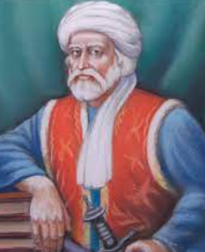
Pashto Poets
Khushal Khan :
Khošāl Khān Khaṭak, also known as Khushal Baba, was a Pashtun poet, chief, and warrior. Khushal Khan served the Mughal Empire protecting them from Pashtun warriors over most of his lifespan
Born: 1613, Akora Khattak
Died: February 25, 1689, Tirah

Slide 15
Cuisines and Culinary Traditions
KPK's cuisine reflects a blend of flavors influenced by its geographical location and neighboring regions. Traditional dishes like chapli kebab, seekh kebab, karahi, and pulao are popular and enjoyed by locals and visitors alike. The food often incorporates aromatic spices and local ingredients, resulting in mouth-watering culinary experiences.

Slide 16
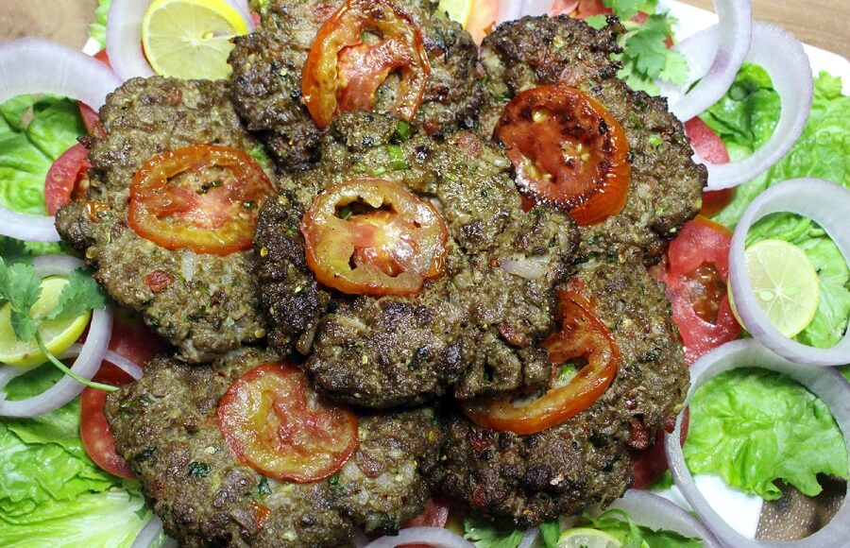
Cuisines and Culinary Traditions
Chapali Kabab

Slide 17
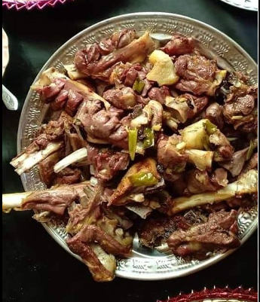
Cuisines and Culinary Traditions
Charsi Tikka :

Slide 18
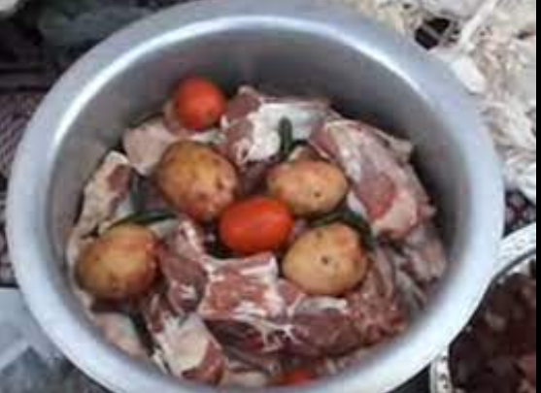
Cuisines and Culinary Traditions
Dampukht :

Slide 19
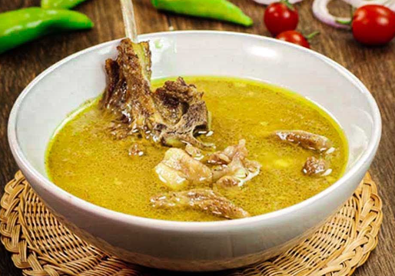
Cuisines and Culinary Traditions
Rosh :

Slide 20
Arts and Crafts
KPK boasts a rich tradition of arts and crafts, showcasing the creativity and craftsmanship of its people. Handwoven carpets and rugs, intricate woodwork, and vibrant embroidery are just a few examples of the artistic skills that have been passed down through generations. The colorful and detailed patterns in their artwork often reflect local folklore and natural surroundings.

Slide 21
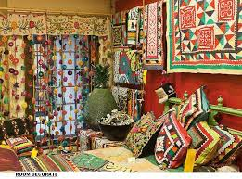
Arts And Craft

Slide 22
Music and Dance
Music and dance hold a special place in KPK's cultural fabric. The traditional Pashto music, characterized by soulful vocals and rhythmic beats, is accompanied by instruments like the rabab, harmonium, and tabla. Popular dance forms, such as Attan and Khattak, involve energetic movements and are performed during festive occasions, weddings, and cultural events.
Rubab
Mangay
Rabab Mangay

Slide 23
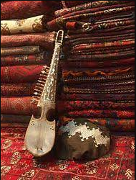
Music Instruments
Rubab :

Slide 24
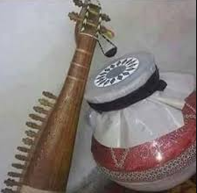
Music Instruments
Mangay :

Slide 25
Folk Dances of KPK
Attan : is a vigorous and rhythmic dance performed by men and women, both separately and together. It is a traditional dance form that showcases the pride and valor of the Pashtun people. Attan involves circular formations, handclapping, and synchronized movements to the beat of traditional instruments like the drums and flute.
Khattak: Khattak Dance is named after the Khattak tribe and is renowned for its powerful and athletic movements. It is predominantly performed by men and features impressive spinning, jumps, and footwork.

Slide 26
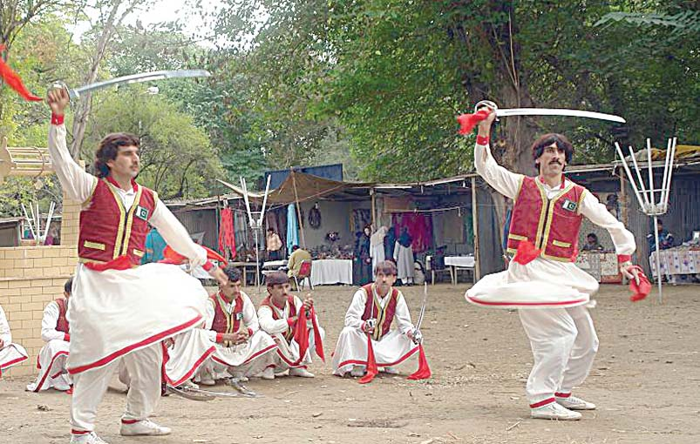
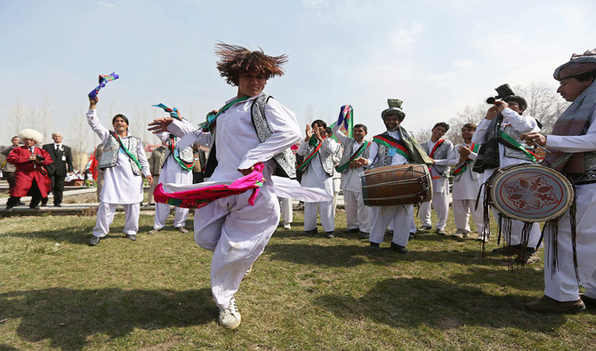
Folk Dances of KPK

Slide 27
Cultural Heritage Sites
KPK is home to numerous historical and archaeological sites that bear testimony to the region's rich heritage. The ancient Buddhist ruins of Takht-i-Bahi and the awe-inspiring architecture of the Mahabat Khan Mosque in Peshawar showcase the cultural diversity and historical significance of the region.

Slide 28
Takht-i-Bahi
Takht-i-Bahi is an Indo-Parthian archaeological site of an ancient Buddhist monastery in Mardan, Khyber-Pakhtunkhwa, Pakistan. The site is considered among the most important relics of Buddhism in all of what was once Gandhara, and has been "exceptionally well-preserved."
The monastery was founded in the 1st century CE and was in use until the 7th century. The complex is regarded by archaeologists as being particularly representative of the architecture of Buddhist monastic centers from its era. Takht-i-Bahi was listed as a UNESCO World Heritage Site in 1980.

Slide 29
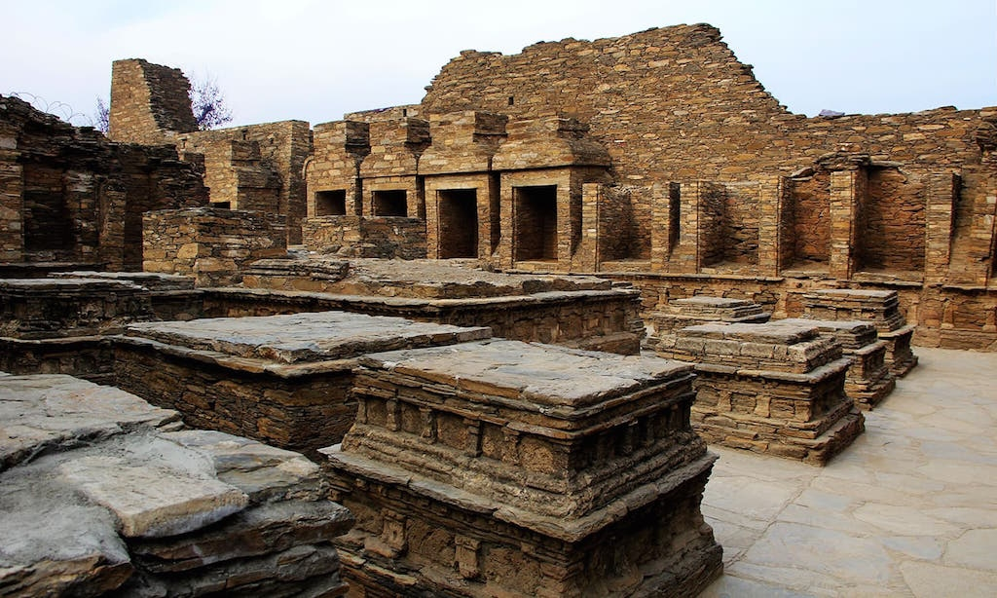
Takht-i-Bahi

Slide 30
Mahabat khan mosque
The Mahabat Khan Mosque, is a 17th-century Mughal-era mosque in Peshawar, Pakistan. The mosque was built in 1630, and named after the Mughal governor of Peshawar, Nawab Mohabbat Khan Kamboh, father of Nawab Khairandesh Khan Kamboh. The mosque's white marble façade(exterior) is considered to be one of Peshawar's most iconic sights.
The minarets of the Mohabbat Khan Mosque were frequently used in Sikh times for hanging prisoners. Five people per day were hanged from the minarets, `as a substitute for the gallows’. Following the Soviet invasion of Afghanistan, refugee tribal elders would congregate in the mosque in order to forge unity amongst Afghans against the Soviets.

Slide 31
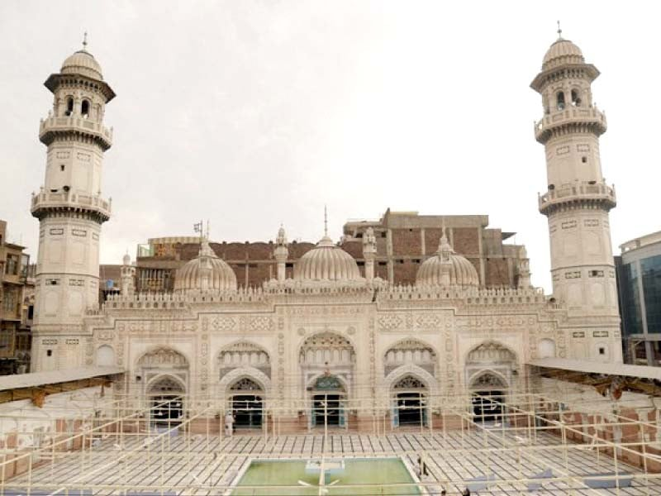
Mahabat khan mosque

Slide 32
Bala Hisar Fort
Bala Hissar is a historic fortress located in Peshawar, Khyber Pakhtunkhwa, Pakistan. First mentioned by 7th-century explorer Xuanzang, the fort was used as a royal residence for the Durrani Empire since 1747, when the Afghan king, Ahmad Shah Durrani, conquered Peshawar. The Marathas briefly occupied it after capturing Peshawar in 1758 but it was soon retaken by the Afghans. The Sikhs destroyed and reconstructed the fort after capturing Peshawar in March 1823. In 1849, the British East India Company reconstructed the fort's outer walls.
The fort now serves as headquarters for Pakistan's Frontier Corps.

Slide 33
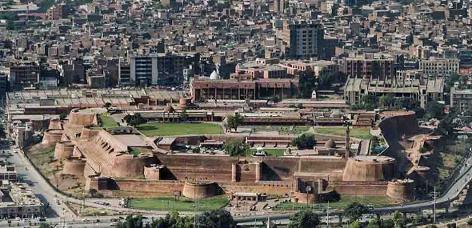
Bala Hisar Fort

Slide 34
Conclusion
In conclusion, Khyber Pakhtunkhwa's culture is a vibrant tapestry woven together by the traditions, values, arts, and celebrations of its diverse communities. The province's rich heritage, music, dance, festivals, and mouth-watering cuisine contribute to its unique identity.

